Slide 1
DIGITAL PORTFOLIO
STUDENT NAME: SRI PRATHEESHWARI .A
REGISTER NO AND NMID:24132261802522015/autanm22622624ucs016
DEPARTMENT:II. B SC.COMPUTER SCIENCE
COLLEGE:OPR MEMORIAL ARTS AND SCIENCE FOR WOMEN(LAKSHMIPURAM)/ ANNAMALAI UNIVERSITY

Slide 2
IBM SKILL’S BUILD
FRONT END WEB DEVLOPMENT

Slide 3
AGENDA
1.Problem Statement
2.Project Overview
3. End Users
4.Tools and Technologies
5.Protfolio design and Layout
6.Features and Functionality
7.Results and Screenshots
8.Conclusion
9.GitHub Lint

Slide 4
PROBLEM STATEMENT
🕷
Problem Statement – Digital Portfolio In today’s competitive digital era, traditional resumes and CVs are no longer sufficient to effectively showcase an individual’s skills, projects, and achievements
👨‍
Many students and professionals lack a structured online presence, which limits their ability to highlight their work in an engaging and accessible way
👨‍🥇
A digital portfolio addresses this gap by providing an interactive platform to present qualifications, skills, projects, and experiences in a visually appealing manner, making it easier for recruiters, educators, and collaborators to evaluate one’s true potential.

Slide 5
PROJECT OVERVIOW
PERSONL WEBSITE
🌐 Personal Website A central platform to showcase projects, skills, achievements, and contact details
👔 Responsive Design Accessible on all devices to ensure maximum reach and usability
💼 Opportunity Creator Structured to help recruiters and clients easily evaluate expertise

Slide 6

END USERS
Key End Users:
Recruiters Purpose: To evaluate skills and projects for potential employment opportunities.
2. Clients Purpose: To review past work before collaborating on new projects.
3. Peers/Community Purpose: To share work, gain visibility, and inspire others in the tech community.

Slide 7
TOOLS AND TECHNOLOGIES
FRONTEND
HTML, CSS, Javascript
VERSION CONTROL GIT
VERSION CONTROL
Git & GitHub
7
DEPLOYMENT
GitHub pages/Netify
DEVELOPMENT
VS-code(For code representation)

Slide 8

PORTFOLIO DESIGN &LAYOUT
Design Philosophy:
Clean & minimal layout focusing on content and user experience
Key Sections:
Home / About Me
Skills
Projects
Contact

Slide 9
FEATURES AND FUNCTIONALITY
⚓
Responsive Design – Works seamlessly on desktop & mobile devices.
👮‍
Navigation Menu – With smooth scrolling between sections.
🎮
Project Showcase – With detailed screenshots and descriptions.
📞
Contact Form – With email integration for easy communication.

Slide 10
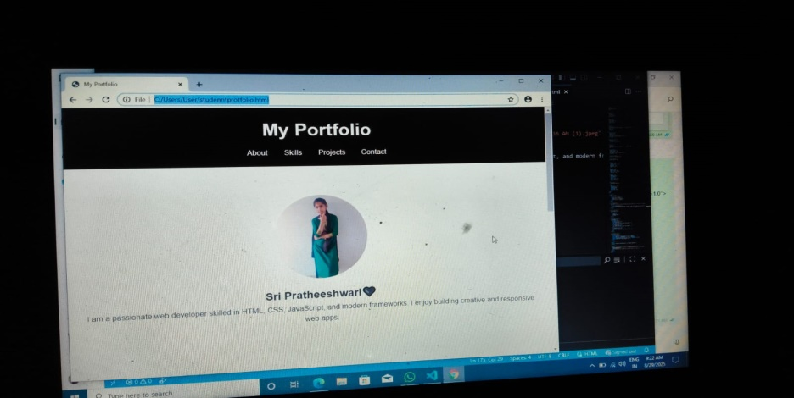
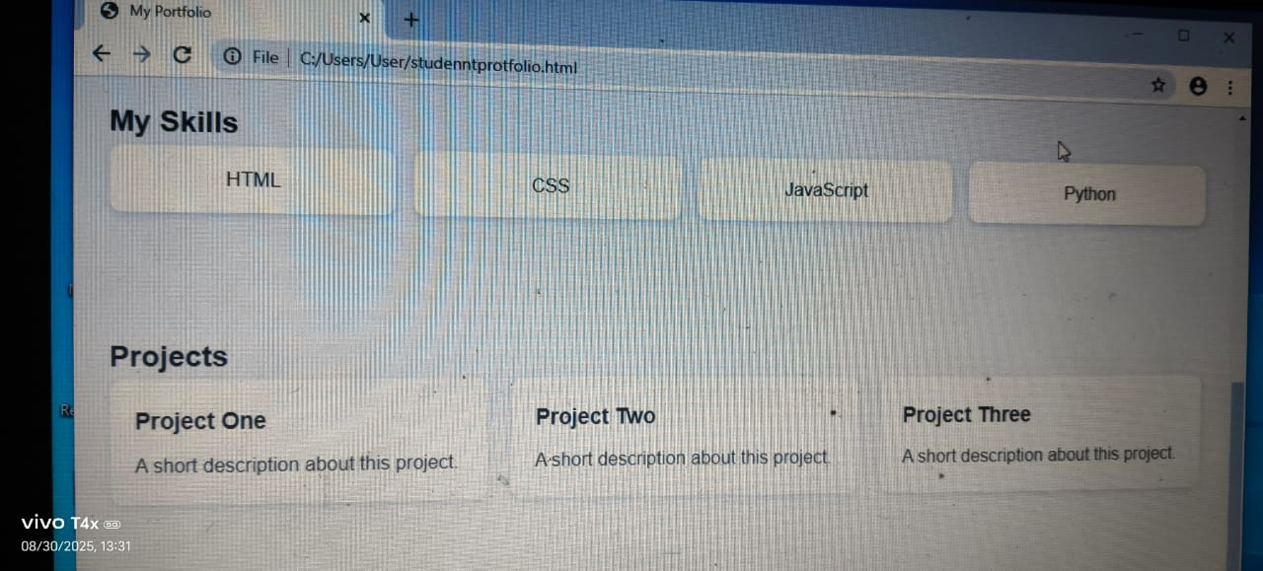
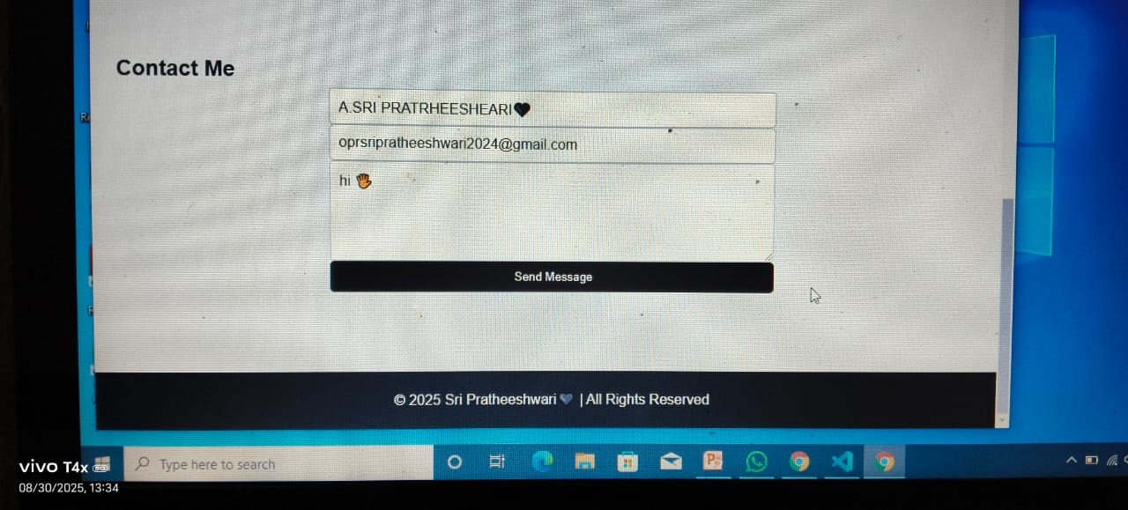
RESULTS AND SCREENSHOTS
with responsive design across different screen size The completed portfolio website showcasing all sections

Slide 11

CONCLUSION
A professional portfolio effectively highlights skills and achievements.
Helps in career growth and networking opportunities.
Continuous updates keep it relevant in the ever-changing tech landscape.

Slide 12
GITHUB LINK

